Slide 1
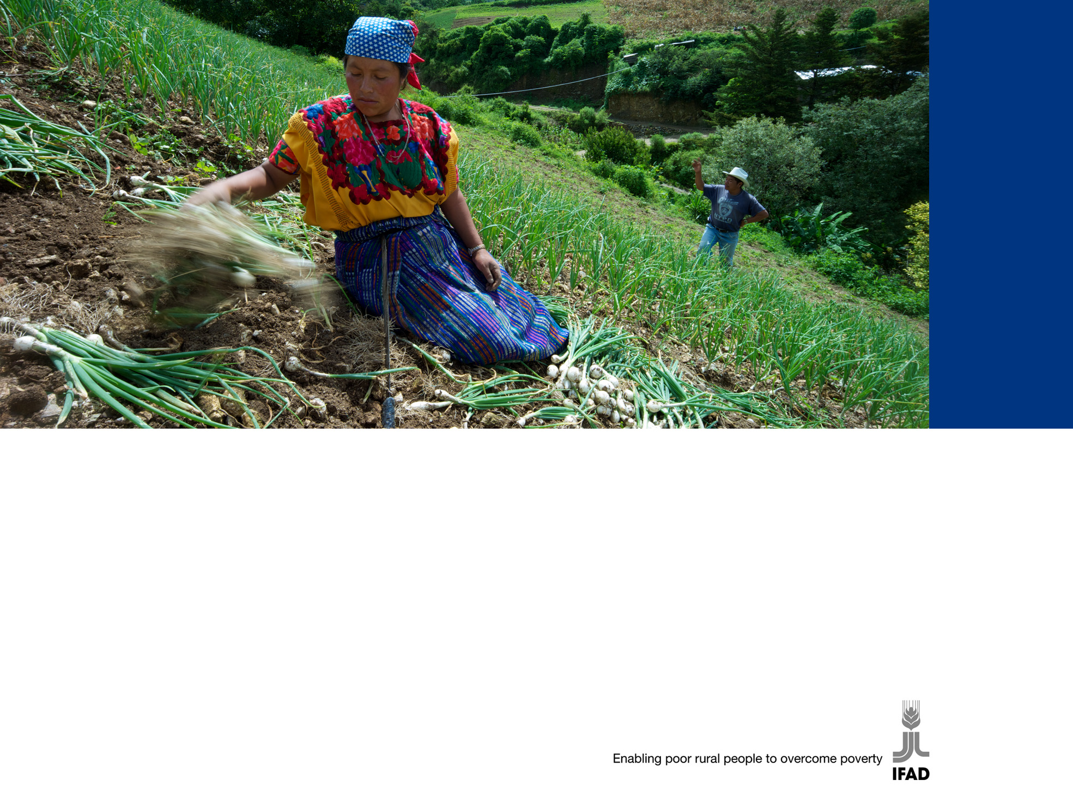
Ninth Replenishment of IFAD’s Resources
South-South cooperation in
IFAD’s business model
24-25 October 2011

Slide 2

SSC policy framework in IFAD
Agreement Establishing IFAD
IFAD’s Lending Policies
and Criteria
8th Replenishment Consultation Report
IFAD Strategic Framework 2011-15
IFAD’s Engagement with Middle-Income Countries
SSC in IFAD’s Business Model for the 9th Replenishment Consultation

Slide 3
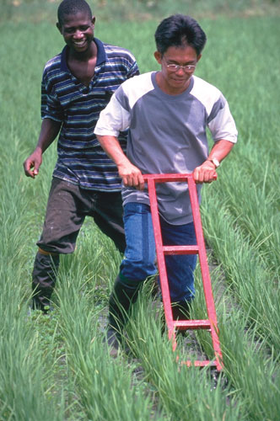
Current IFAD SSC
SSC-focus in many IFAD Country Strategies (e.g. India, China, Brazil)
Strengthening project designs and KM strategies
Technology transfer facilitation and expertise mobilization
Grants in support of direct knowledge exchanges

Slide 4
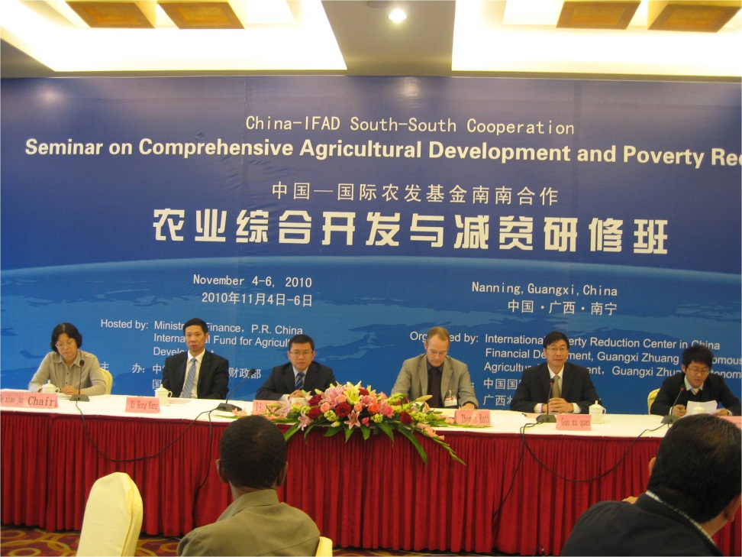
How SSC is implemented in IFAD
Project managers’ “exchange”, sharing, learning and replicating
Technical expertise from developing countries
(i.e. India-Indonesia)
Private sector mobilization
Analytical work and regional networks: i.e. IFADAsia “South-South development theme” expansion

Slide 5
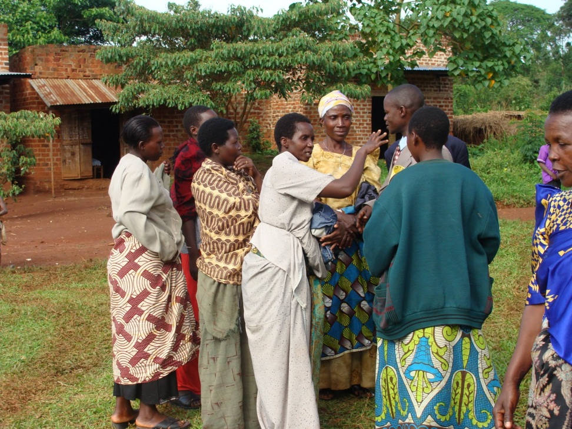
A best practice in SSC: the Learning Routes
All stakeholders sharing and learning in the field
Focus on best practices
Local knowledge paid;
self-esteem growth
Innovation plans
Support for adaptation, replication and implementation
On-line platforms

Slide 6
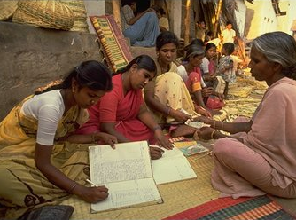
Value added for IFAD: relevance
Appropriate knowledge
Focus on country needs
Scouting for rural innovations

Slide 7
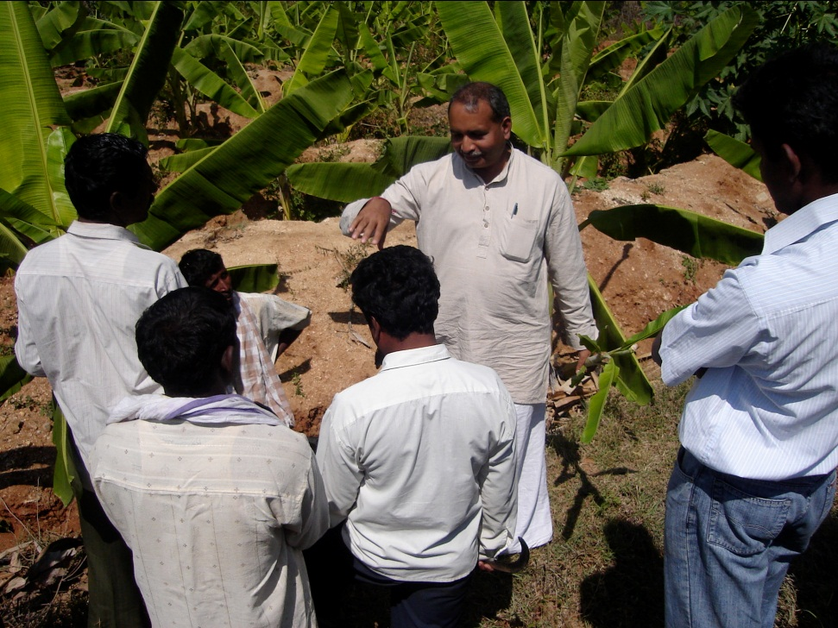
Value added for IFAD: effectiveness
Sustainability
Replication and scaling up potential
Probability of reaching development objectives

Slide 8
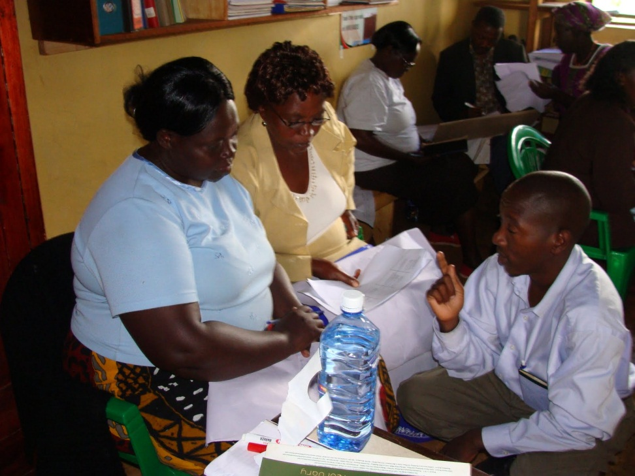
Value added for IFAD: efficiency
Costs and risks reduction, with different business and different risks
The Morocco-Mauritania example: technical expertise shared;
earlier and predictable
scaling up

Slide 9

Value added for IFAD: policy engagement
The example of the IFAD-supported REAF (Reunion Especializada sobre Agricultura Familiar)
A new commitment gathering smallholder farmers, their families, their countries, and IFAD

Slide 10
Country differentiation
Country needs, demands, opportunities
Providers’ and receivers’ flexibility
IFAD as a broker,
a “supporter” and
an “observing partner”
MICs
MICs
LICs
LICs

Slide 11

Lessons learned
Support SSC champions
Demand-driven process
Good-quality norms
Evidence-based KM to share good practices

Slide 12
The evolving IFAD approach to SSC
What are IFAD clients looking for?
  New ideas; innovation and concreteness
  Mainstreaming SSC into strategic and operational documents: IFAD policies, country strategies, projects and grant designs….
  Training for southern cooperation agencies or development banks
  Twin arrangements for capacity building

Slide 13
Managing SSC in IFAD
Present: diversity, flexibility, innovation, decentralization
Future: corporate strategic dimension
  SSC systematization
  Scaling up
  Monitor financing of South-South cooperation
  by IFAD
  Continue brokering and facilitating
  Establish a virtual best practices’ “marketplace” where demand and offer can meet

Slide 14

Conclusion
IFAD is already “doing” SSC
Raise level of mainstreaming of SSC in IFAD strategic and operational documents
Mobilize country offices to strengthen IFAD’s contribution to South-South cooperation

Slide 15

Thank you
Thank you!

