Slide 1
The Independent Office of Evaluation of IFAD
Country Programme Evaluation Nigeria
93rd session of the Evaluation Committee, 6 September 2016

Slide 2
IFAD ongoing portfolio

Slide 3
CPE Process
Project performance of CBARDP (May-June 2015),
Included visits to project sites in 4 Northern States (Kebbi, Sokoto, Katsina and Jigawa)
CPE main mission (September 2015)
Visits to project sites in 9 States (Oyo, Lagos, Edo, Rivers, Abia, Cross Rivers, Benue, Nasarawa and Niger)
Stakeholder meetings in Abuja, Ibadan, Lagos, Abia (with stakeholders from Akwa Ibom), and Port Harcourt
National Roundtable in April 2016
ACP signed in June 2016

Slide 4
Strategic shift towards agriculture
Strategic shift towards agriculture under 2nd COSOP
Better alignment with Government policies and strategies (Vision 20:2020, ATA) and IFAD’s core business (smallholder agriculture)
Move from integrated community development programmes - with broad social and economic investments - to market-led, commodity-based value chains and rural finance
Long timespans - strategic shift led to multiple design adjustments over programme lifetime (‘re-design turbulence’)

Slide 5
Targeting
Greater focus on the poorer North under 2nd COSOP
Geographic targeting lacks reliable poverty data
Broad multi-region coverage created gaps and prevented overlaps & synergies
Interventions geographically spread out and scattered through 27 States (~90 LGs)
Targeting within communities through participatory processes
Attention to women and youth
9.2 million beneficiaries reached - out of the 14.2 million targeted

Slide 6
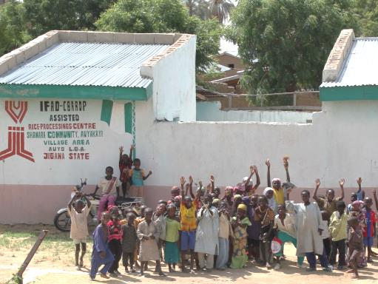
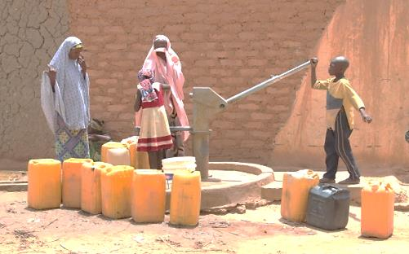
Islands of results
Concentrated investments in a limited number of villages
Asset creation, access to financial services, community capacity building and job creation
Life-changing impacts in hard-to-reach communities
Overall impact rather limited, given the scale of the country and poverty depth
Notes:
e.g. CBARDP: 207 selected village areas, 28,116 investments into community infrastructure, sustainable agricultural development, rural enterprise and financial linkages support and gender and vulnerable group development

Slide 7
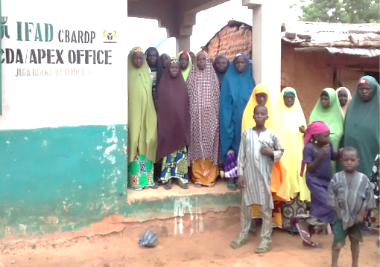
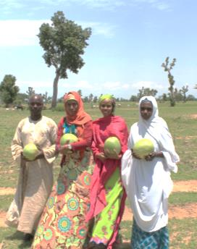
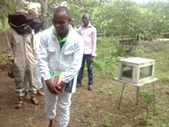
Community capacities
IFAD’s comparative advantage – community based approaches
Community Development Associations (CDAs) as a 4th tier of government in the North; Commodity Apex Development Associations (CADAs)
Good sustainability in the North; governments funding; State legislation

Slide 8
Efficiency
Average start-up delay 26 months (2x IFAD average)
State government commitments low or lagging; frequent political changes
Geographic stretch with large number of states and LGAs led to high management overheads (≥ 20%)
CDD programmes almost 30% management overheads, but good allocative efficiency and better cost efficiency

Slide 9
Policy engagement
Country office - cost-efficient opportunities for policy dialogue through sector working group, grants and the platform created by RUFIN
Partnerships - opportunistic and ad hoc; not strategic; mainly within programmes;
Absence of a well-structure policy coordination unit within FMARD limited policy influence and coherence
Increased attention to knowledge management, but limited evidence from the field (poor M&E)

Slide 10
Conclusions
Good results through strong commitment at local (state and community) level.
Low efficiency limits achievement of results (late start-ups, high management overheads)
Overall impact small, given the size of the country and the depth of poverty (“islands of results”)
Many factors contributing to successful engagement at local level; more difficult to address in larger programmes
Scaling up of results and impact requires improved systems for coordination, knowledge management and M&E at federal level

Slide 11
Recommendations
Geographic focus, transformed state-level partnerships and realistic levels of counterpart funding – to address issues of state commitment
Increase leverage and presence in operations - through linking loans and grants, supervision, capacity for state engagement, high-level policy engagement
Dedicate resources to important crosscutting issues, incl. conflict, pastoralism, youth and gender.
Expand existing and develop new & more strategic partnerships particularly outside of government
Build on IFAD’s knowledge management strategy by improving the quality of evidence from the field

