Slide 1
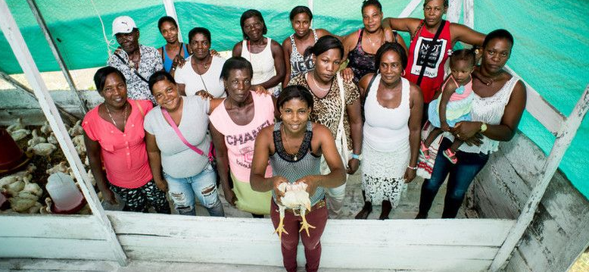
Preview of the results-based work programme and budget for 2020 and indicative plan for 2021-2022 of the Independent Office of Evaluation of IFAD
106th Evaluation Committee
2 September 2019

Slide 2
IOE 2020 work programme
Joint Corporate level evaluation with the evaluation offices of WFP and FAO on country-level collaboration among RBAs
Thematic evaluation on IFAD’s contribution to smallholder adaptation to climate change
Country strategy and programme evaluations: Bolivia, Pakistan, Morocco, Niger and Uganda
Evaluation synthesis report on Rural Infrastructure
One new impact evaluation
8 project performance evaluations
Validation of all project completion reports available in the year
2020 ARRI
1

Slide 3
2020 resource envelope
Staff resources
Same level
Proposed 2020 budget: US$ 6.15 million
Recruitment of Director IOE: US$150 000
New Evaluation Policy: US$50 000
*Subject to change based on revised standard staff costs to be provided by Office of Strategic Budgeting
Budget is 0.43 per cent of IFAD’s expected programme of loans and grants for 2020. The cap on IOE budget set by Executive Board is 0.9 per cent.
 | 2019 budget | Proposed 2020 budget
Non-staff costs | 2 510 390 | 2 480 390
Staff costs | 3 473 221 | 3 473 221*
Total budget | 5 983 611 | 5 953 611
2

