Slide 1

IFAD10 Impact Assessment Report:
Corporate Estimates & Projections
Sara Savastano
Director, Research and Impact Assessment Division
Strategy and Knowledge Department
2 September 2019, Evaluation Committee

Slide 2
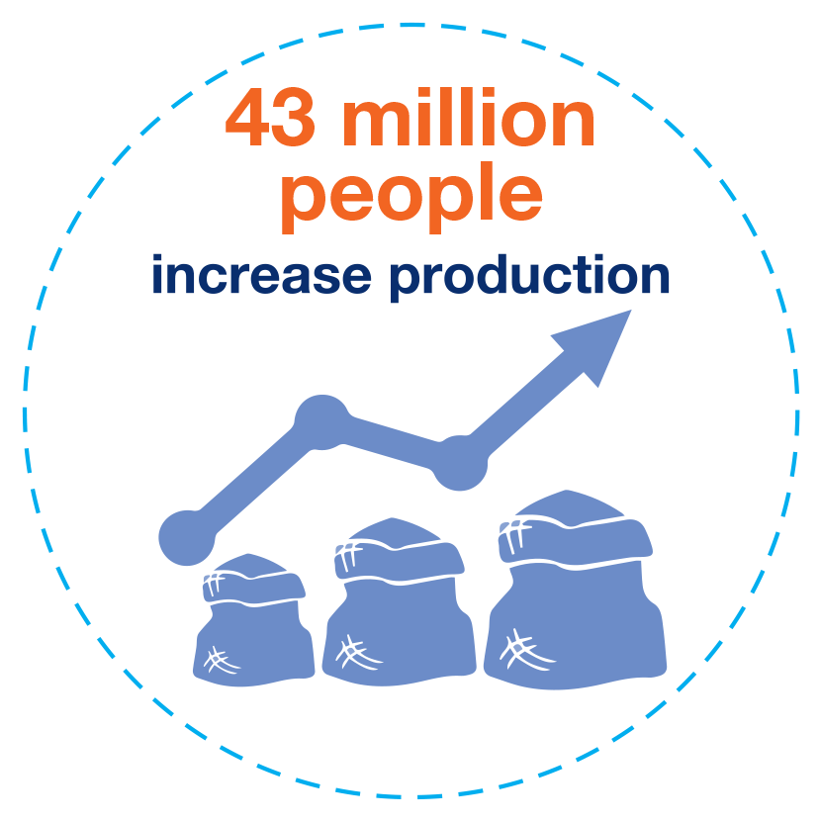
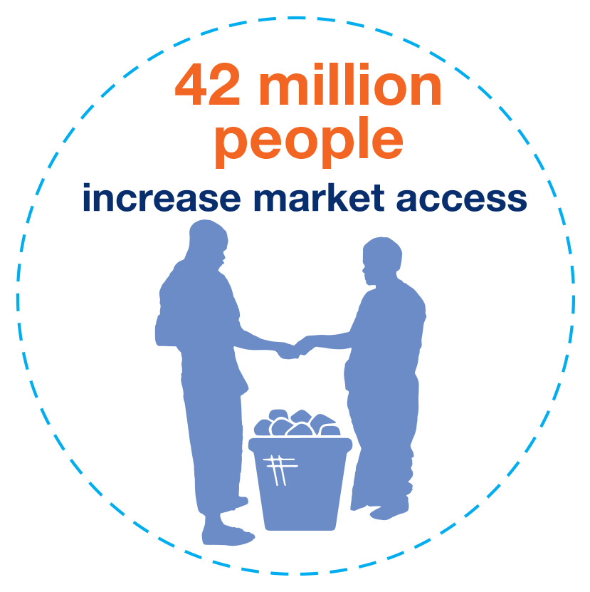
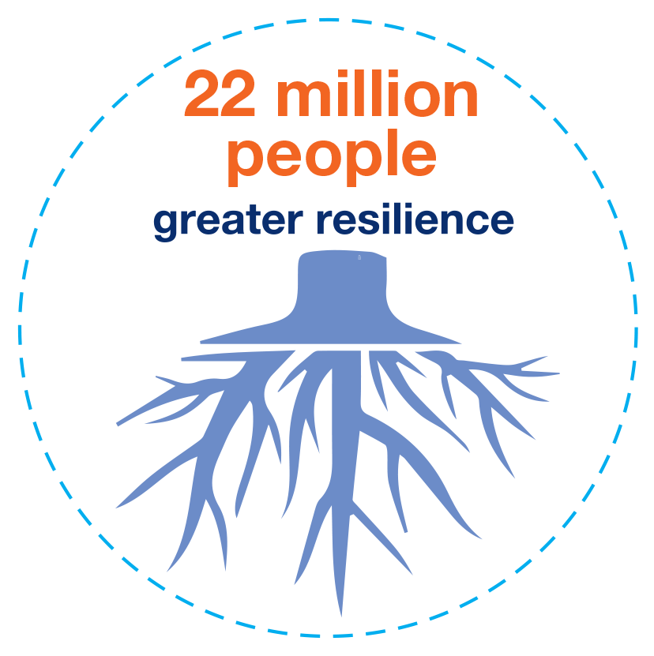
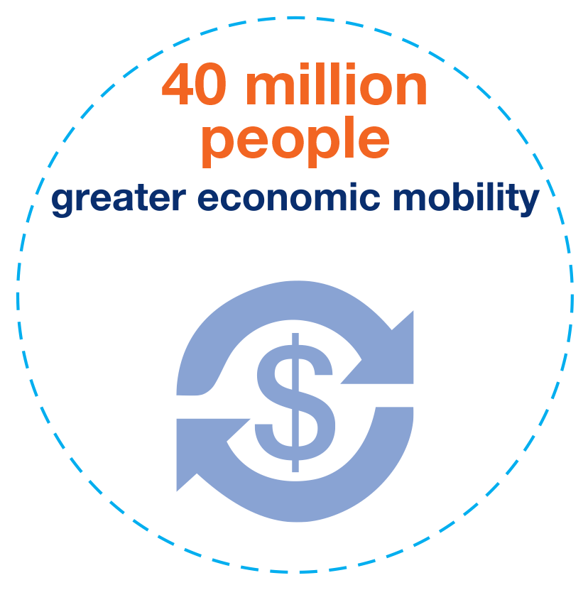
IFAD10 Targets by Strategic Objective and Goal
Strategic Objective 1
Strategic Objective 2
Strategic Objective 3
Strategic Goal
Notes:
With the Development Effectiveness Framework, IFAD decided to link Targets to SOs and Goal. Under the overarching goal of promoting eco mob to 40M, IFAD committed to increase ag prod to 43 M, increase market access and strengthening resilience.

Slide 3
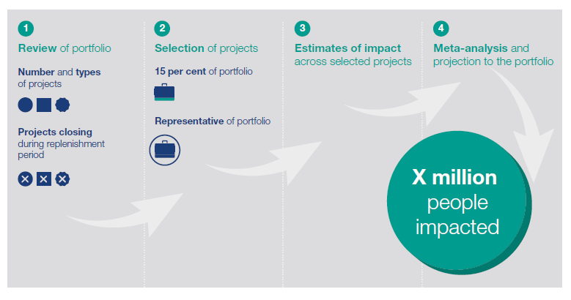
IFAD10 Approach for measuring impact
Notes:
How does IFAD hold itself accountable to reach these goals?
The answer is a unique approach to conduct CORPORATE REPORTING and IFAD
As laid out in the Development Effectiveness Framework, IFAD has committed to assess the impact of 15% of its project portfolio
The choice of the project, as agreed and reported in the document presented at the EB in 2016 consisted:
had to display the potential for learning
buy-in from the government
be feasible for an impact assessment
An overall an IA had to ensure learning for the design of new project
4 steps: review, selection, estimation of the individual project impact on SO1-SO3 /goal and meta-analysis with projection of the impact to the overall pf.

Slide 4
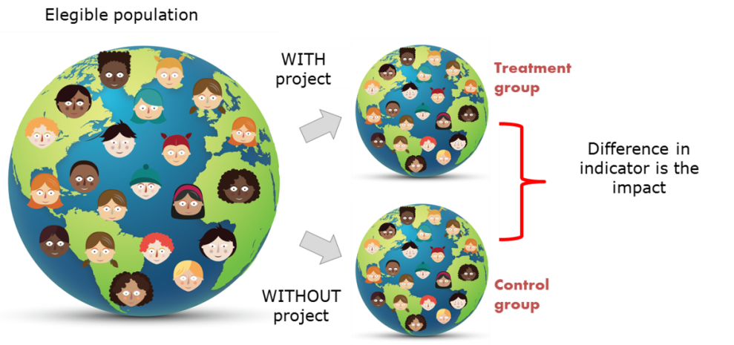
~15% of projects with Attribution
Notes:
The project-level impact assessments use data and statistically methods in order to ensure attribution of project impacts—that is, the assessments seek to guarantee the impact can be attribute to IFAD interventions

Slide 5
IFAD10 IA descriptive statistics
Category | IFAD10 IA projects evaluated | IFAD10 portfolio of completed projects | Share (%)
Studies | 17 | 107 | 16%
Projects | 19 | 107 | 18%
Actual beneficiaries (Millions) | 8.6 | 65.3 | 13%
Total project cost (US$ millions) | 982 | 5,446 | 18%

Slide 6
IFAD10 project-level impacts

Slide 7
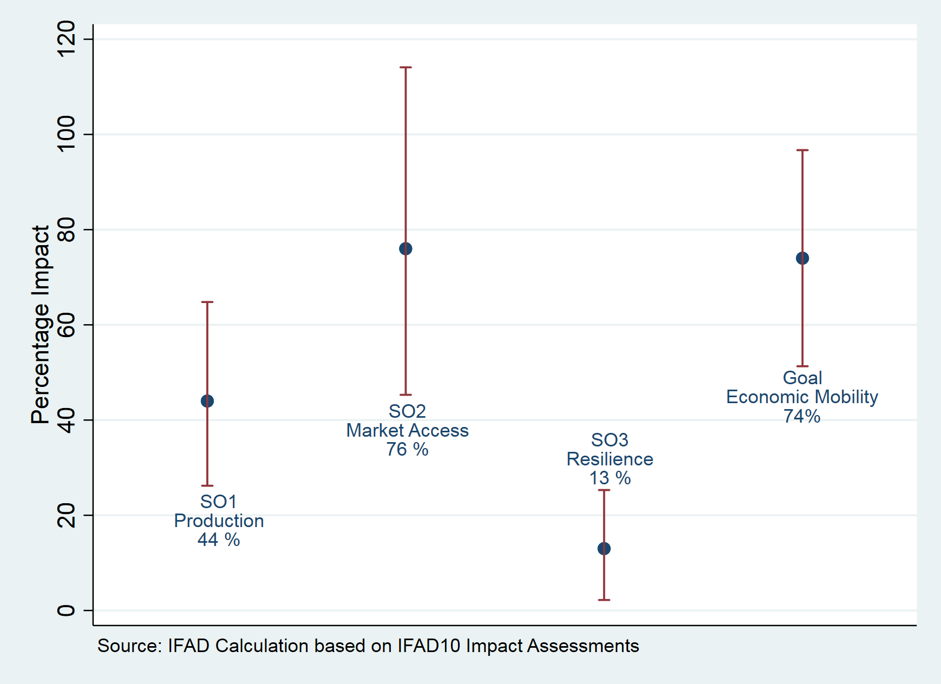
Impacts on Strategic Objectives & Corporate Goal

Slide 8
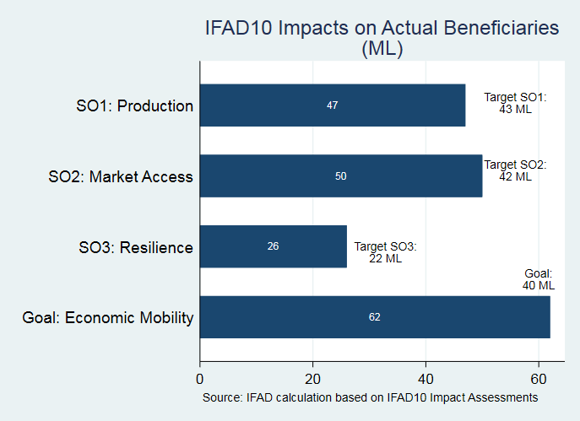
Impact on Beneficiaries
Notes:
Projection on the number of beneficiaries; receiving at least a 20 percent impact gain from project participation
Compared to the overarching goal to promote economi mobility to 40 Ml beneficiaries, we reached overall 55% more
In terms of SOs
SO1: 9% more
SO2: 18% more
SO3: 18% more

Slide 9
IFAD10 IA: 3 Key Messages
#1: Strong Theory of Change Leads to Stronger Impacts.
  More focused and interlinked interventions (infrastructure and marketing in China)
  Going beyond outputs focus on final impacts and the pathways
#2: Benefits from market participation require holistic identification of constraints.
  Income from sales can only increase if all bottlenecks are addressed
  Integrate all actors of the value chain (Nepal: beneficiaries + market participation and increased crop and livestock production)
  #3: Readiness to extreme events
  in precautionary measures to manage risk of extreme events
  safeguards or contingency plans for extreme events

Slide 10
Thank you
https://www.ifad.org/en/impact-assessment

