Slide 1
2019 Annual Report on Results and Impact of IFAD Operations (ARRI)
Evaluation Committee
2 September 2019

Slide 2
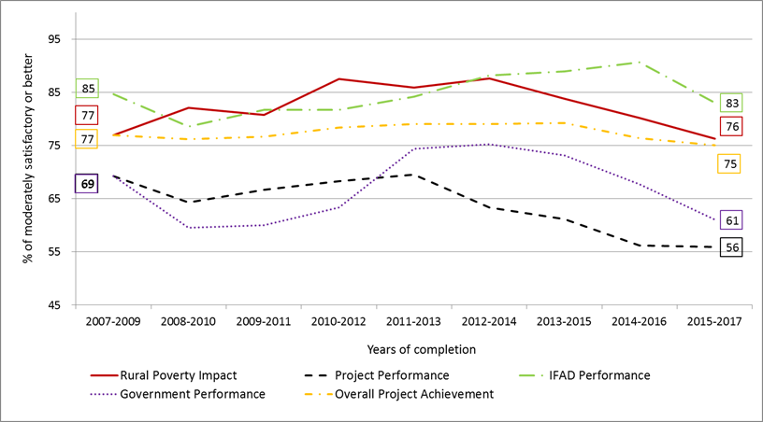
The majority of ratings are positive, however, the trends in performance of IFAD projects show decline in recent years
Overview of main evaluation criteria
% projects rated moderately satisfactory or better
75% of all ratings MS+
2

Slide 3
IFAD project performance is better than other regional IFIs, especially in Asia, but lower than the World Bank
External benchmarking with agricultural portfolio of other IFIs
Percentage of project with positive performance ratings (2002-2017)
Global | IFAD | World Bank*
 | 67 | 74
Africa | IFAD Africa | AfDB
 | 58 | 50
Asia & Pacific | IFAD Asia | AsDB
 | 86 | 64
Latin America & Caribbean | IFAD LAC | World Bank*
 | 71 | 76
Near East/North Africa/ Europe | IFAD NEN | World Bank*
 | 64 | 79
* World Bank does not include sustainability of benefits within its project performance
3

Slide 4
Among all the criteria, only adaptation to climate change reached its IFAD10 RMF target
Evaluation criteria assessment of PMD and IOE
% projects rated moderately satisfactory or better
Outcome indicators | PMD PCR ratings 2016-2018 (73 projects) | IOE PCRV/PPE ratings 2015-2017 (59 projects) | IFAD10 RMF Target 2018
Relevance | 93 | 83 | -
ENRM | 84 | 81 | 90
IFAD performance | 88 | 83 | -
Innovation | 88 | 80 | 90
Rural Poverty Impact | 83 | 76 | 90
Effectiveness | 82 | 75 | 90
Overall Project Achievement | 82 | 75 | -
Adaptation to climate change | 87 | 73 | 50
GEWE | 88 | 71 | 90
Scaling-up | 88 | 68 | 90
Government performance | 79 | 61 | 80
Sustainability | 70 | 59 | 85
Project performance | 68 | 56 | -
Efficiency | 67 | 51 | 80
4

Slide 5
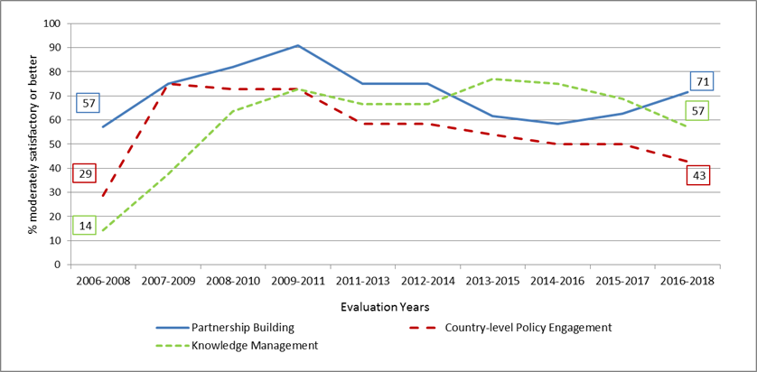
Trends in non-lending activities are declining, except in Partnership building
Performance of all non-lending activities: 64% of projects MS+ (CSPE database)
Positive Factors
Capitalizing good practices, innovations and lessons learned from projects Supporting systematically dialogue and accountability between government and other stakeholders Engaging actors to go beyond the project’s life
Negative Factors
Limited resources, capacities and technical knowledge at country level Absence of functional frameworks and clear objectives in country strategies Inadequate levels of stakeholder representation
5

Slide 6
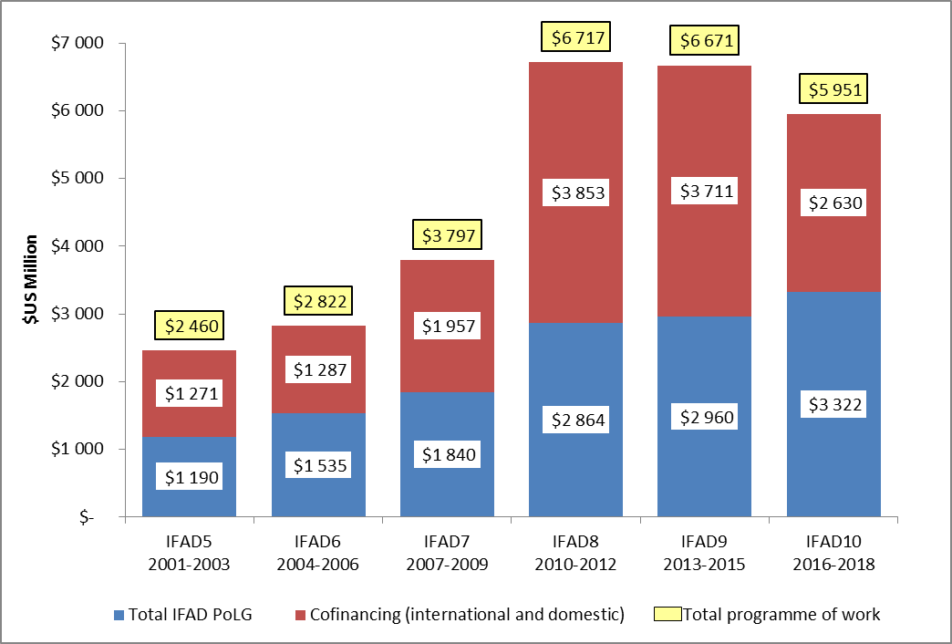
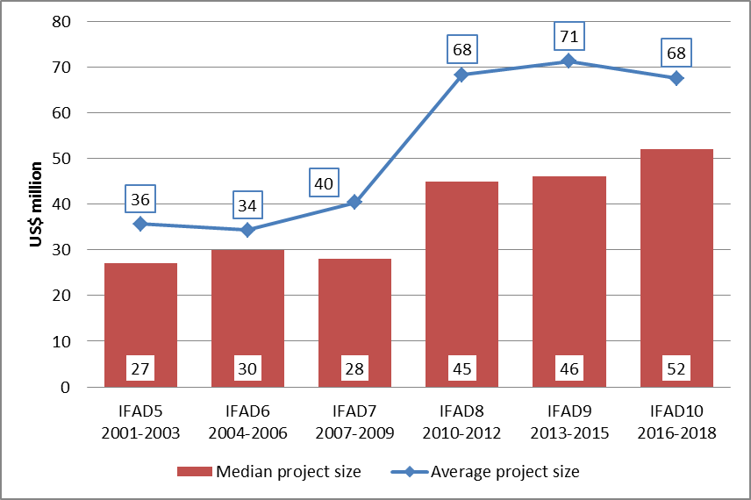
IFAD10 project investments remained big with bigger approved project sizes…
IFAD approved Programme of Work (PoW)
by replenishment period (US$ million)
Total cost per approved investment project (average and median size)
6

Slide 7
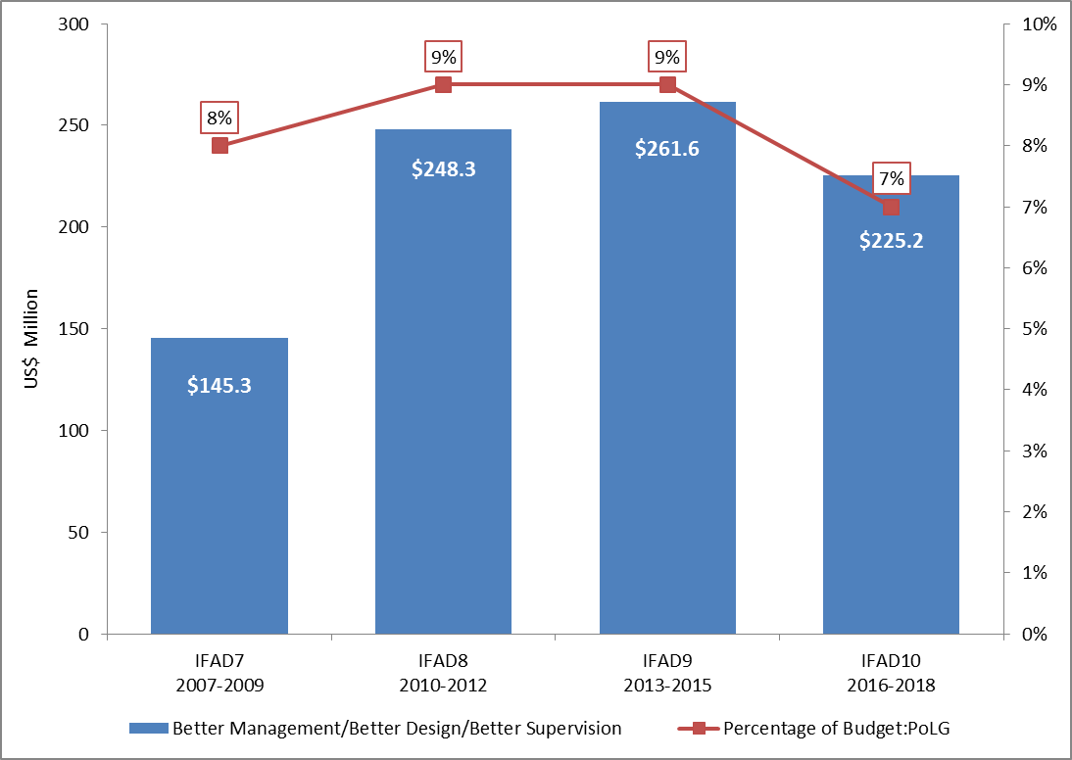
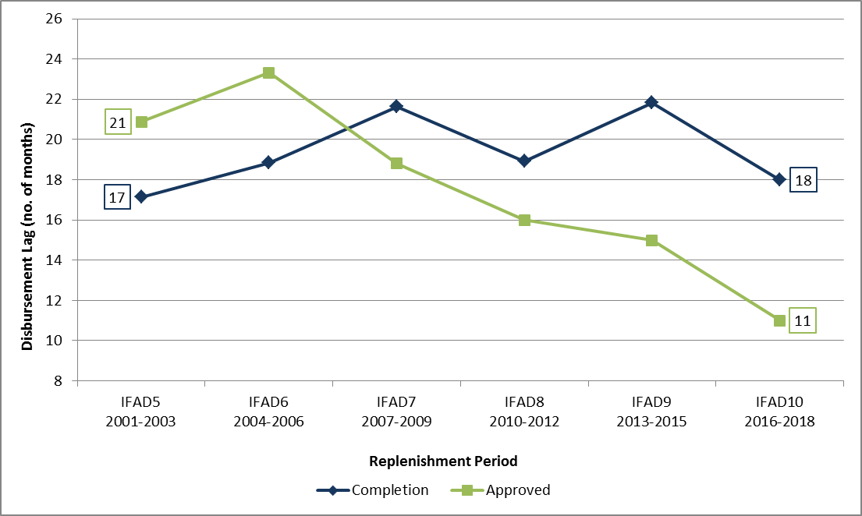
Smarter in terms of reduced budgetary resources and improved timeliness
Administrative budget allocation for country programme, design, supervision & implementation and its ratio to PoLG by replenishment period
Average Disbursement Lag
by replenishment period
7

Slide 8
…, but they were not necessarily better in quality.
Based on IOE ratings, only Adaptation to Climate Change reached its IFAD10 target.
ENRM shows a statistically significant and positive change in terms of average ratings between IFAD8 and IFAD10 as well as IFAD8 and IFAD9.
However, average IOE ratings for all criteria (except adaptation to climate change and ENRM) declined between IFAD8 and IFAD10 as well as IFAD9 and IFAD10 – despite initial improvement between IFAD8 and IFAD9.
Relevance and IFAD performance as a partner show a statistically significant decline in average ratings between IFAD9 and IFAD10.
8

Slide 9
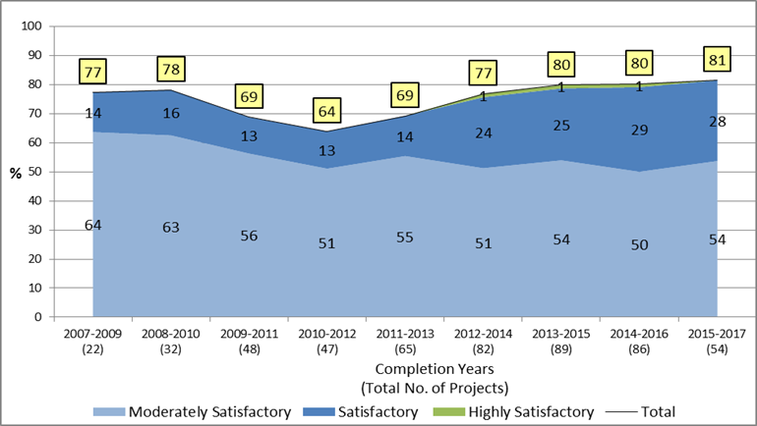
Technical expertise and preventive approaches contributed to positive performance in ENRM
ENRM: 81% of projects MS+ (PCRV/PPE data series)
90% IFAD10 Target
Positive Factors
Recognizing sensitive ecosystem in the design phase Adopting long-term environmentally sustainable farming methods Adopting legal frameworks to avoid environmental implications
Negative Factors
Lack of environmental strategy at design No focus on human capital in environmental management
9

Slide 10
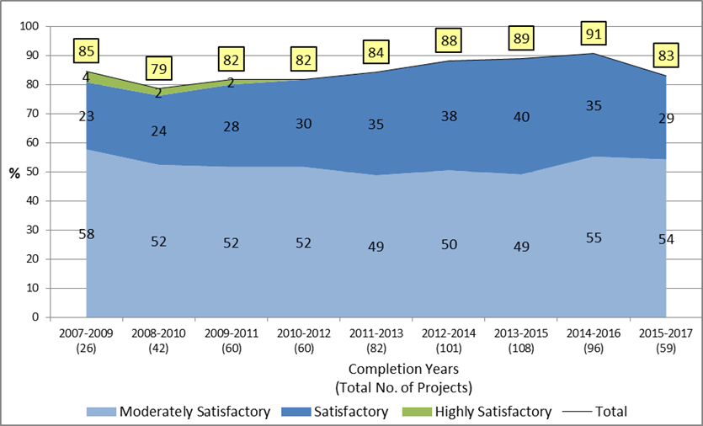
Limited budget and expertise contributed to recent downturn in IFAD performance as a partner
IFAD performance as a partner: 83% of projects MS+ (PCRV/PPE data series)
Positive Factors
Flexible design and adaptability to changing contexts Learning from previous experiences High quality of knowledge management Presence at country level to ensure partnerships
Negative Factors
Limited budget and absence of specialists for supervision missions High staff turnover, delayed disbursements
10

Slide 11
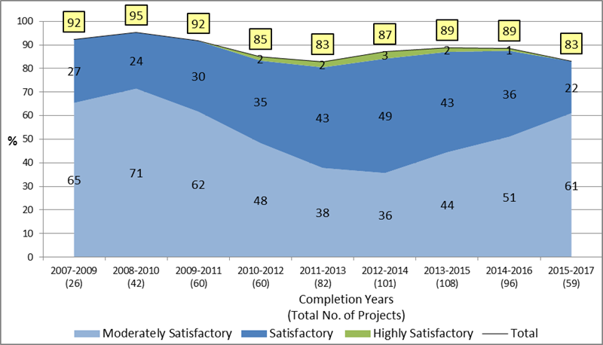
The decline in Relevance stems from diminishing satisfactory and better ratings related to issues with project design
Relevance: 83% of projects MS+ (PCRV/PPE data series)
Positive Factors
Flexible project design and good targeting aiming at inclusiveness and sustainability Synergy among components Demand-driven and participatory approaches allowing to meet market requirements
Negative Factors
Poor targeting mechanisms Ambitious design Insufficient country context analysis Inadequate recognition of appropriate policies and supervising framework
11

Slide 12
Continued relevance requires adapting the design throughout implementation
Five Lessons from the Learning Theme on Relevance
Ensuring the “continued relevance” of a project intervention requires adapting the design throughout implementation.
Meaningful engagement of beneficiaries in the design, implementation and evaluation of projects enhances project relevance.
Government commitment is critical in adopting pro-poor policies and designs, in providing adequate implementation capacity, and ensuring continued project relevance.
Limited implementation capacity and a lack of understanding of institutional arrangements can impede the relevance of even the best designs.
Well-functioning institutions are a key determinant of higher relevance.
12

Slide 13
2019 ARRI Recommendations
Dedicate more resources to country programme delivery – specifically to project design, supervision and implementation – to achieve the improved quality needed for "better" IFAD performance.
Design IFAD programmes and projects based on country capacities and ensure that implementation arrangements are the most appropriate for country delivery.
Develop government capacities to design and implement country programmes and projects in collaboration with other partners.
Determine earlier the need to adjust project designs to ensure their "continued relevance" to the country context.
Devise a more comprehensive and coherent system to better mitigate risks in IFAD projects and programmes.
13

Slide 14
2020 ARRI - Proposed Learning Themes
Quality of IFAD's Supervision and Implementation Support (SIS): Given the observed decline in annual SIS missions per project, this learning theme would examine the quality of recent SIS missions in terms composition, expertise and advice;
Efficiency: The criterion efficiency measures how economically resources/ inputs (funds, expertise, time) are converted into results. Greater emphasis is now being place on "value for resources" and IFAD's value for money proposition. In this context, the learning theme would explore the quality of results per dollar invested in IFAD projects.
14

Slide 15
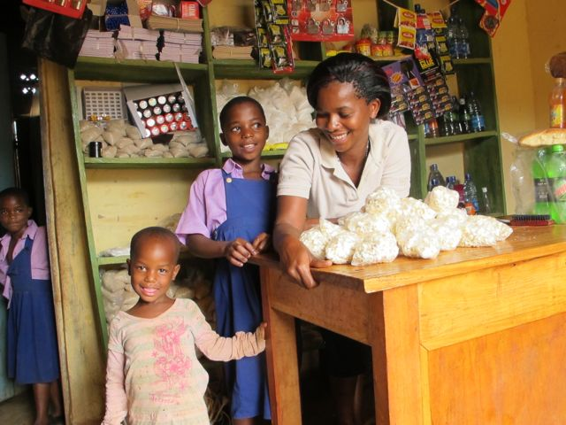
Thank you for your attention.
Questions & Answers

Slide 16
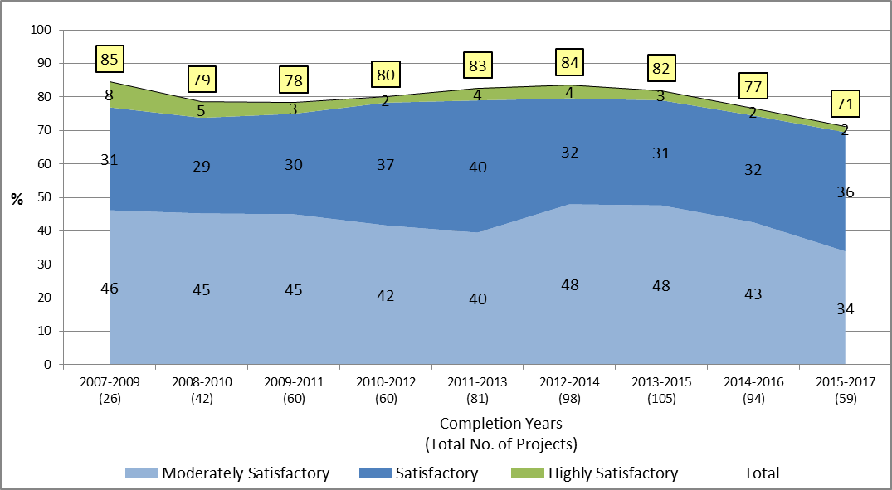
Last year’s overall declining trend in GEWE confirmed, though the proportion of “satisfactory” ratings rose
GEWE: 71% of projects MS+ (PCRV/PPE data series)
90% IFAD10 Target
Positive Factors
Gender-sensitive project design and including women in self-help and farming group Promoting women’s participation in value chains activities and leadership roles, as well as in business management and technology transfer training
Negative Factors
Absence of gender strategy at design and lack of gender specialist during implementation Lack of dialogue with local institutions
16

Slide 17
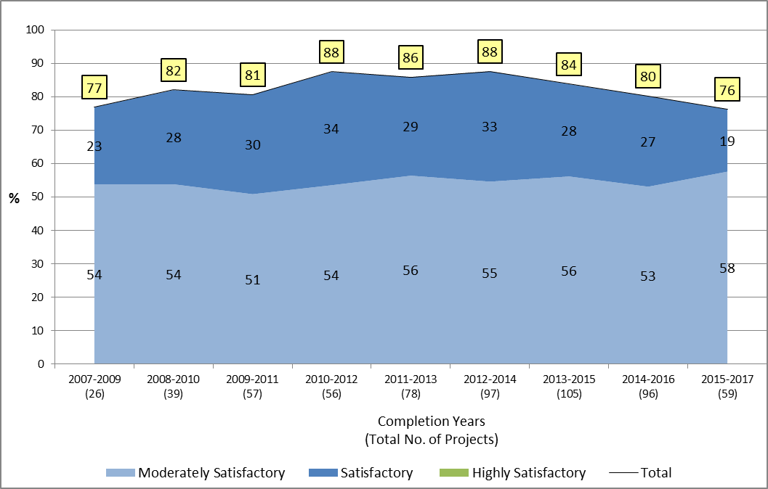
Significant gaps in the targeting strategy and processes led to a decline in rural poverty impact performance
Rural Poverty Impact: 71% of projects MS+ (PCRV/PPE data series)
90% IFAD10 Target
Positive Factors
Building capacity of public institutions and staff Diversifying cultivation techniques, with increased access to technology Supporting bottom-up approach and empowerment of young and ethnic minorities Forming community-based organizations
Negative Factors
Significant gaps in the targeting strategy and processes Missing structured value chains approach Lack of data and of clear policy frameworks to guide long-term sustainability
17

Slide 18
Only adaptation to climate change ratings improved between IFAD9 and IFAD10, based on PCR ratings
Evaluation criteria assessment PCR (IFAD9 and IFAD10)
% projects rated moderately satisfactory or better
Outcome indicators | IFAD9 PCR ratings (2013-2015) 113 projects | IFAD10 PCR ratings (2016-2018) 73 projects | IFAD10 RMF Target 2018
Adaptation to climate change | 79 | 87 | 50
Government performance | 84 | 79 | 80
GEWE | 90 | 88 | 90
Innovation | 92 | 88 | 90
Scaling-up | 93 | 88 | 90
ENRM | 88 | 84 | 90
Rural Poverty Impact | 89 | 83 | 90
Effectiveness | 86 | 82 | 90
Efficiency | 75 | 67 | 80
Sustainability | 80 | 70 | 85
Project performance | 83 | 68
Overall project achievement | 92 | 82
IFAD performance | 96 | 88
Relevance | 99 | 93
18

Slide 19
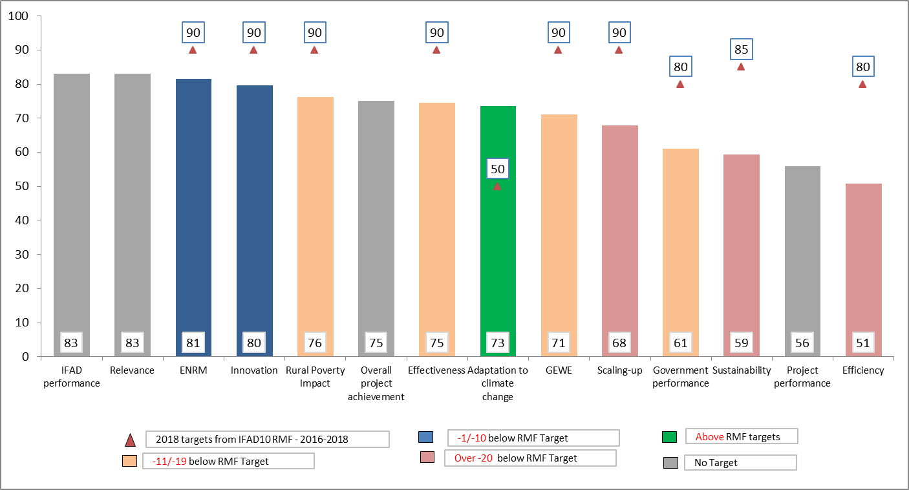
Based on IOE ratings, only adaptation to climate change reached its IFAD10 RMF target
Evaluation criteria assessment (2015-2017)
% projects rated moderately satisfactory or better
4

