Slide 1

IFAD
Corporate Induction &
Senior Management Meet-and-Greet
Agribusiness Hubs:
Creating Employment Opportunities for Rural Youth
ECG/Office of Technical Delivery
Tuesday, 11 February 2025

Slide 2
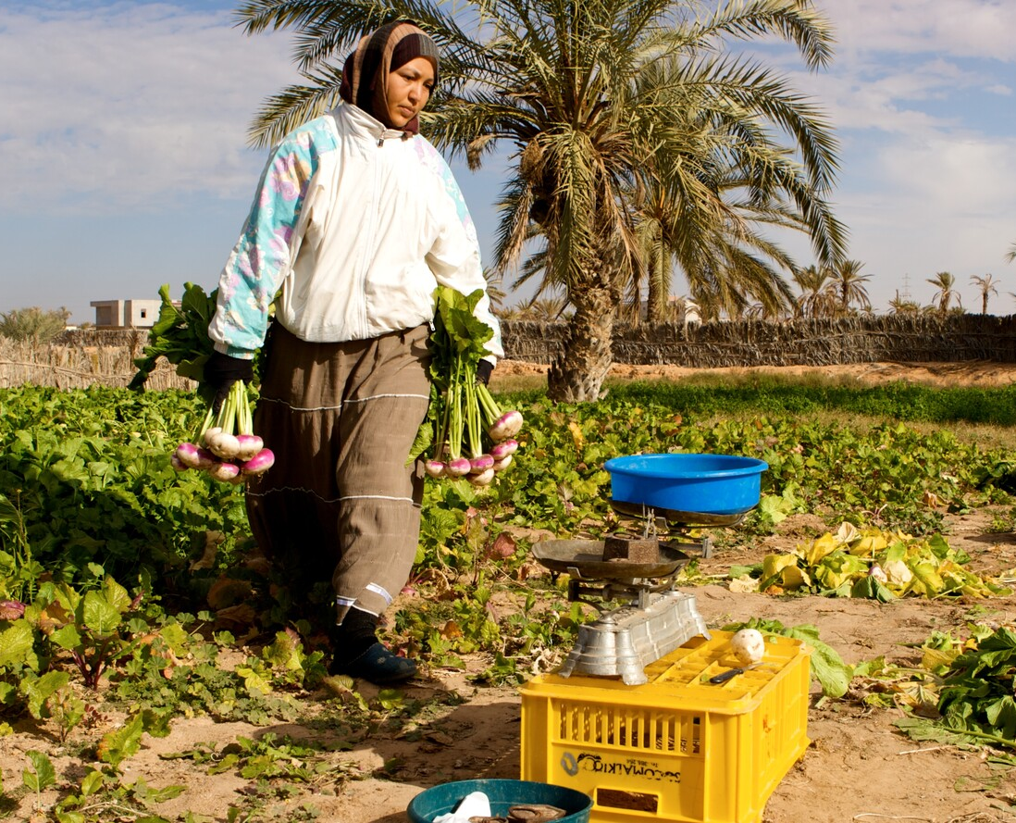
Youth Employment & Demographics
1.2 billion youth (15-24), making up 16% of the global population—Over 83% live in developing countries.
72% rural youth live in countries with low rural transformation.
Unemployment is 13%, triple the adult rate, more than 1 in 5 youth are NEET (not in education, employment, or training).
Investing in decent work opportunities within the agri-food sector can absorb the growing youth labour force and unlock their potential to drive innovation and rural economic development.

Slide 3
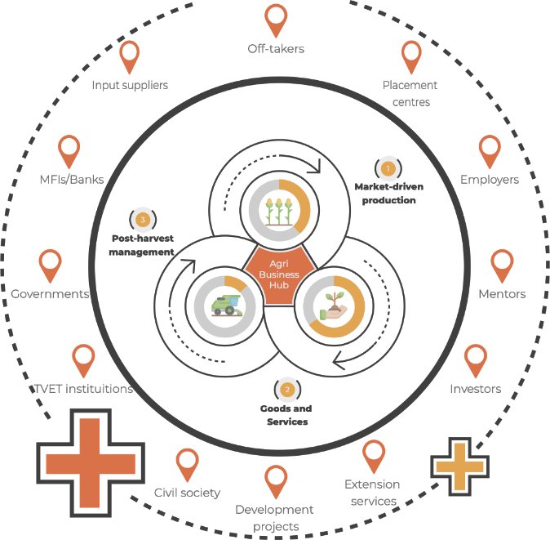
A Structured Multi-stakeholder Approach to Rural Youth Employment
Foster dynamic collaboration among multiple public and private employment ECOSYSTEM ACTORS
Labour market and value chain studies & inclusive targeting strategies to identify opportunities and pathways for youth employment and entrepreneurship, and skills requirements
Demand driven skills and capacity development, including internships, apprenticeships, job placement, business support services/acceleration, access to finance and other resources
Coaching, mentoring and other follow-up support for wage employment and self-employment

Slide 4
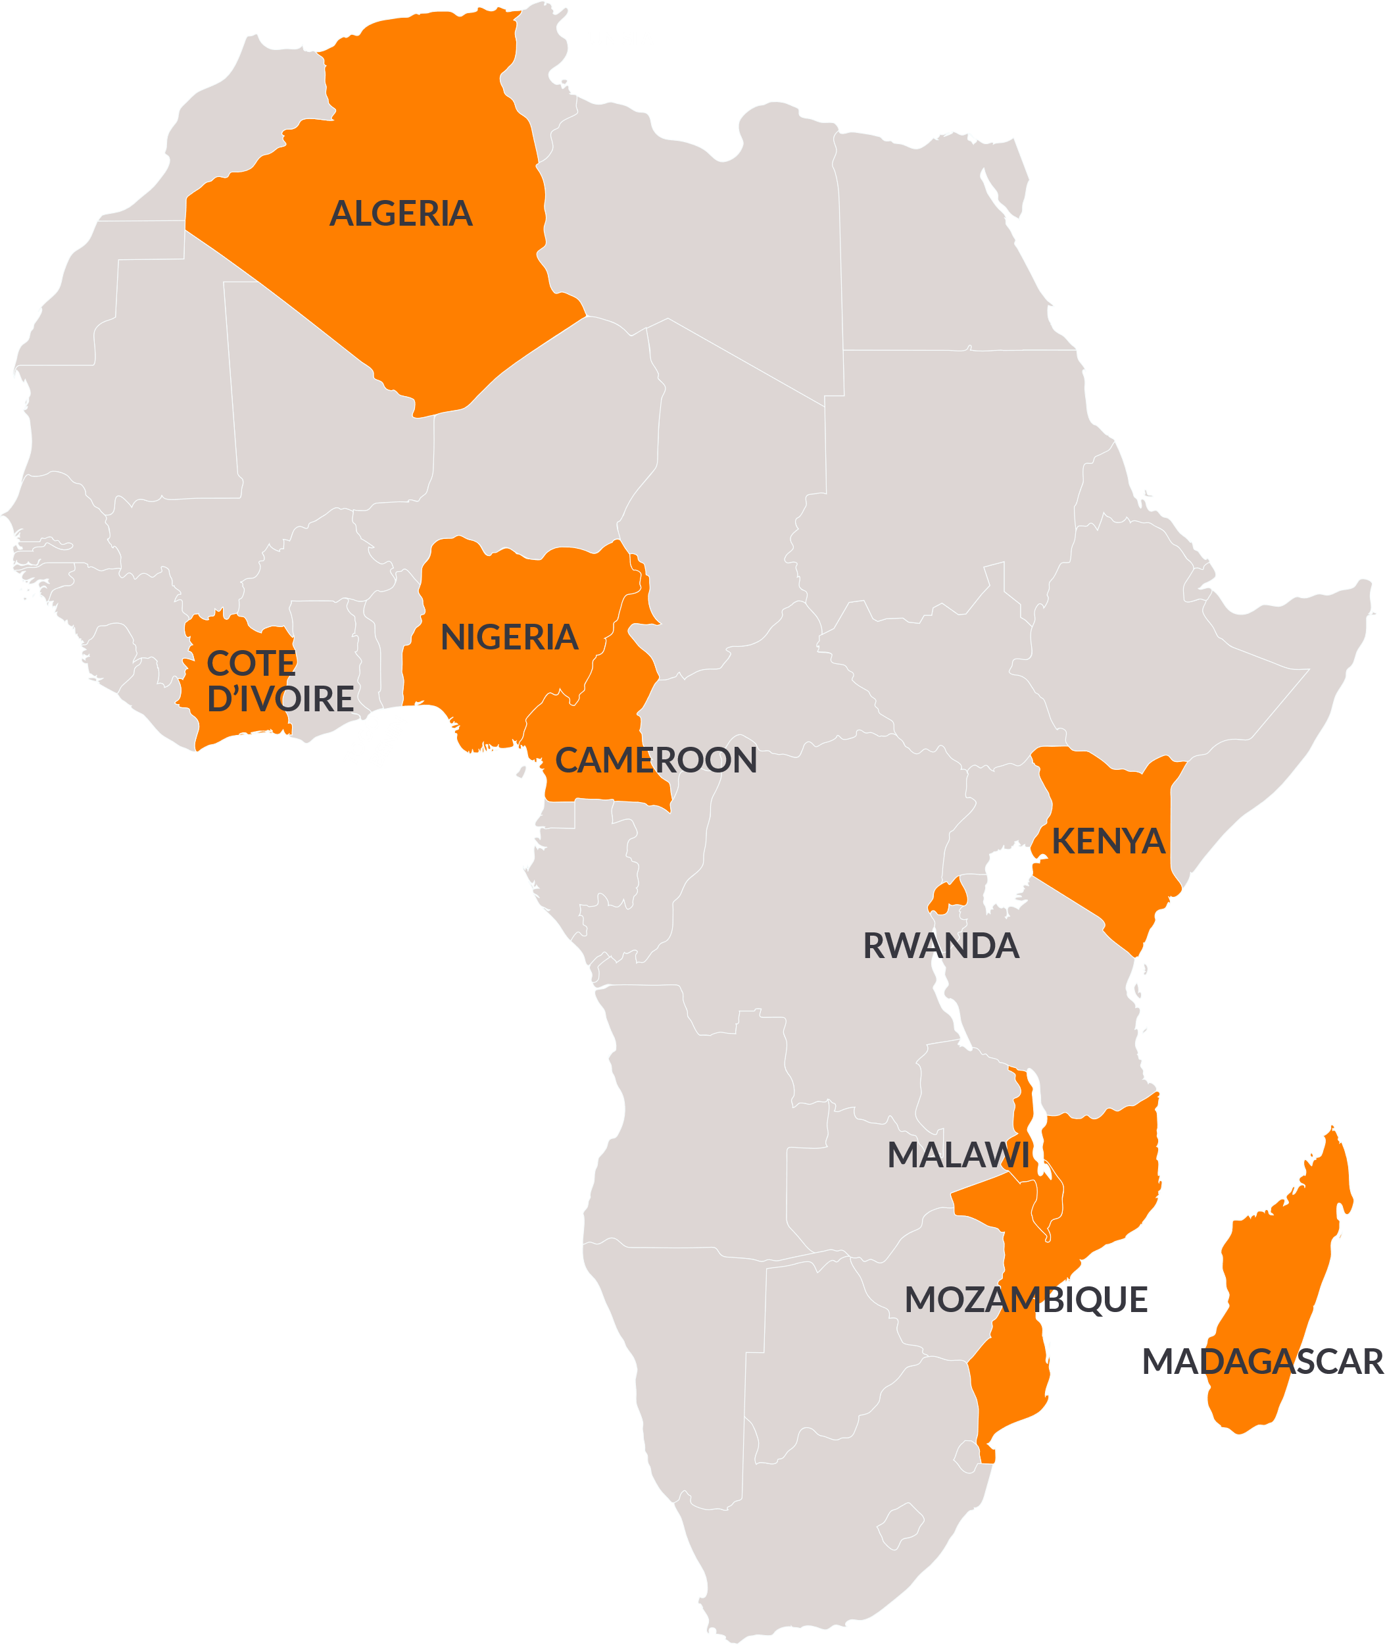
Key Results
32,000DECENT JOBS
created across 9 African countries, surpassing original targets of 22,000
KEY TARGETS SURPASSED BY:
305%
Self employmentl
149%
Jobs created for women
166%
Wage-employment
The first phase ends in 2025 & the Scale-up Phase aims to accelerate and enhance Outreach and Impact.

Slide 5
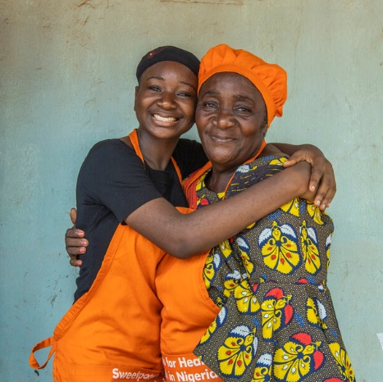
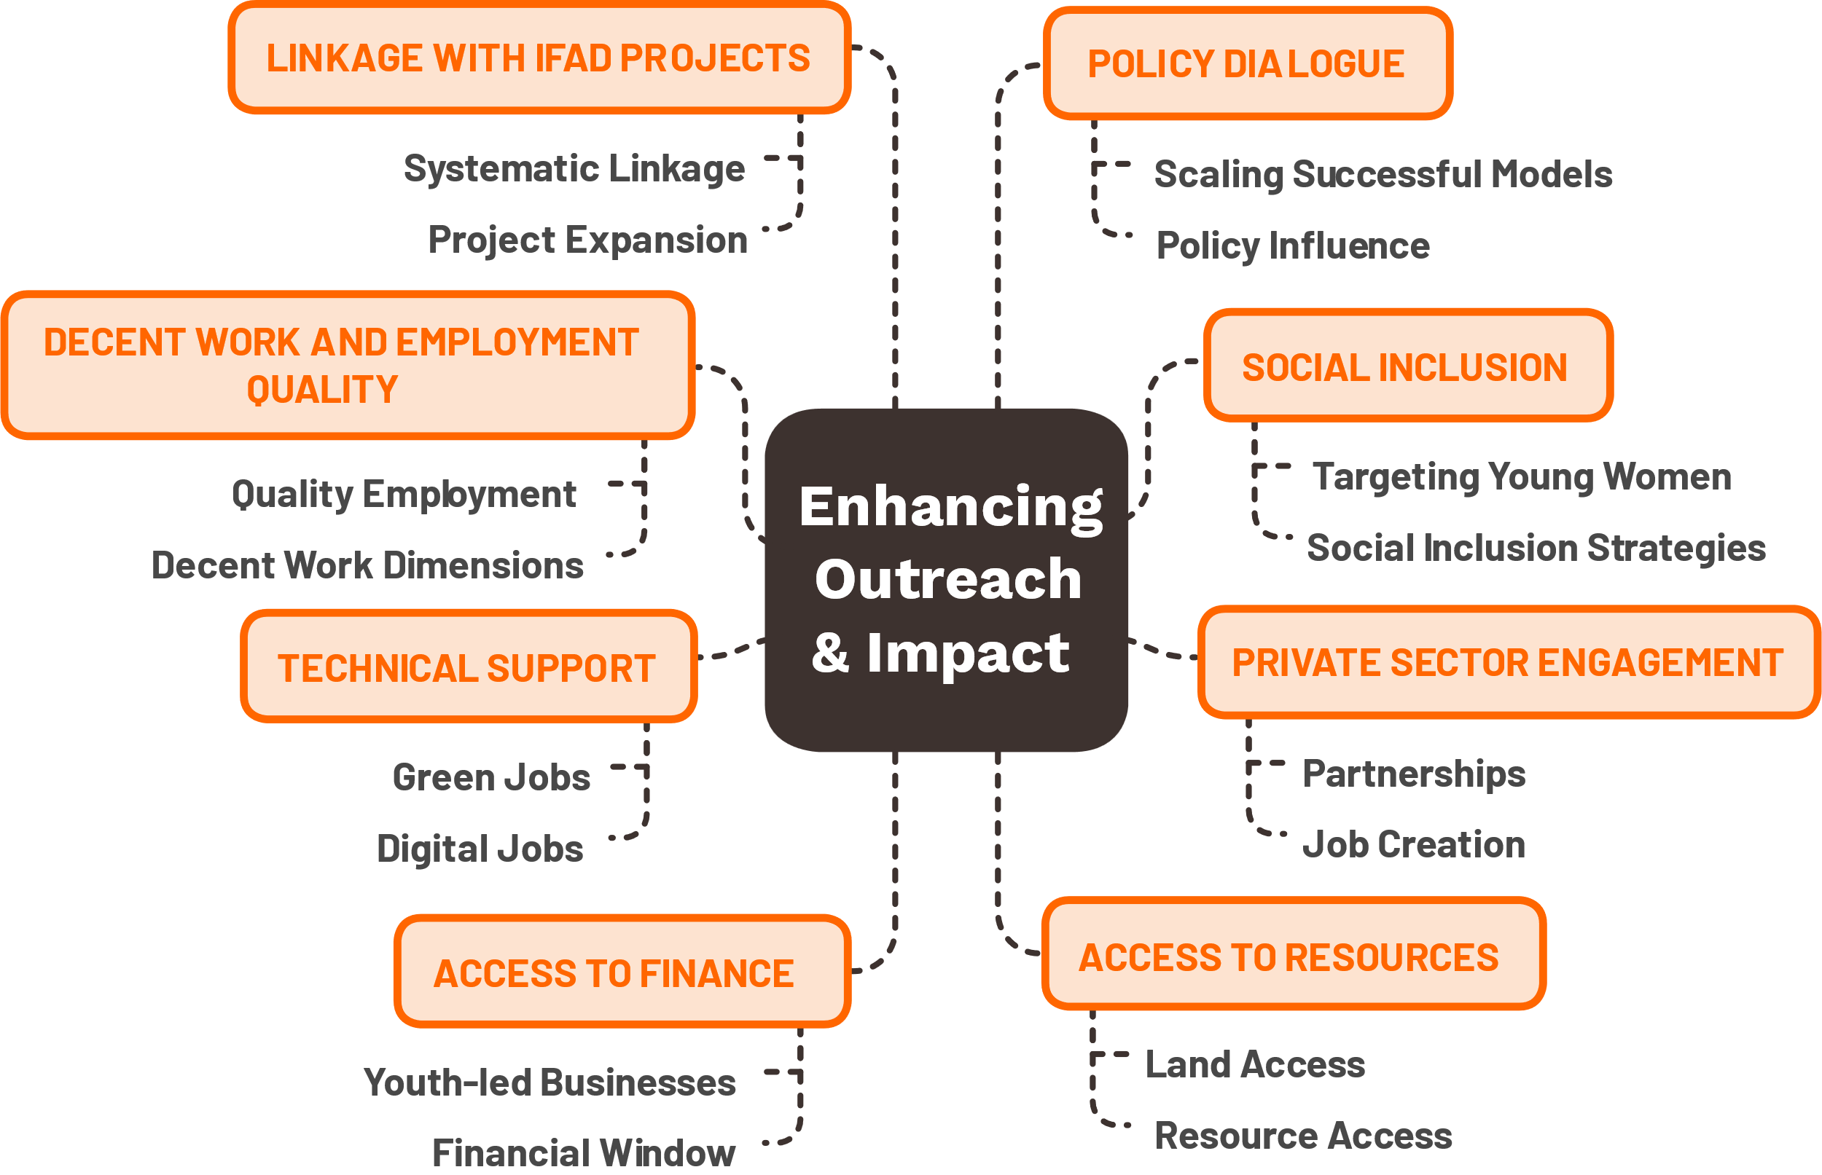
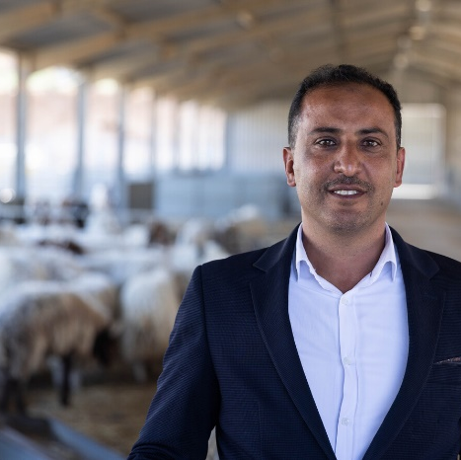
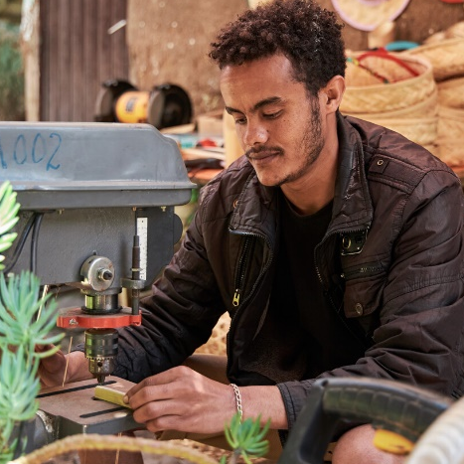

Scale-up Phase: Priorities & Focus
149%
Jobs created for women
166%
Wage-employment
305%
Self-employment
149%
Jobs created for Women
166%
Wage-employment

Slide 6
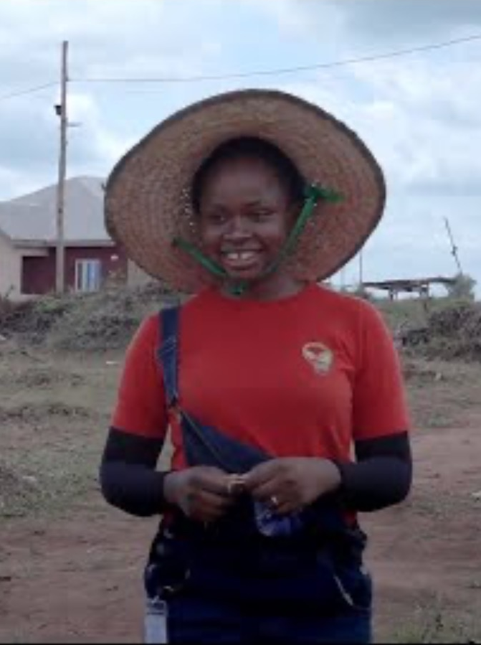


Testimonials
NIGERIA & CAMEROON
MADAGASCAR
MALAWI
Visit the programme website to learn more

Slide 7
Contact
Thank You
Hisham Zehni
Lead Technical Specialist (Youth) & Social Inclusion Cluster Coordinator
ECG division, OTD
IFAD
h.zehni@ifad.org
+39-0654591 Ext. 2183

